Slide 1
Corona virus and its social impacts

Slide 2
Corona virus origins
Unless you live under a rock, you have heard at least something about the virus, that brought the world to its knees - The Corona virus.
SARS-CoV-2 is a novel coronavirus that emerged in the city of Wuhan in Hubei Province, China in 2019. It is a member of the coronavirus family which includes other coronaviruses that have circulated in human populations for a long time and produce mild respiratory infections like the common cold.

Slide 3
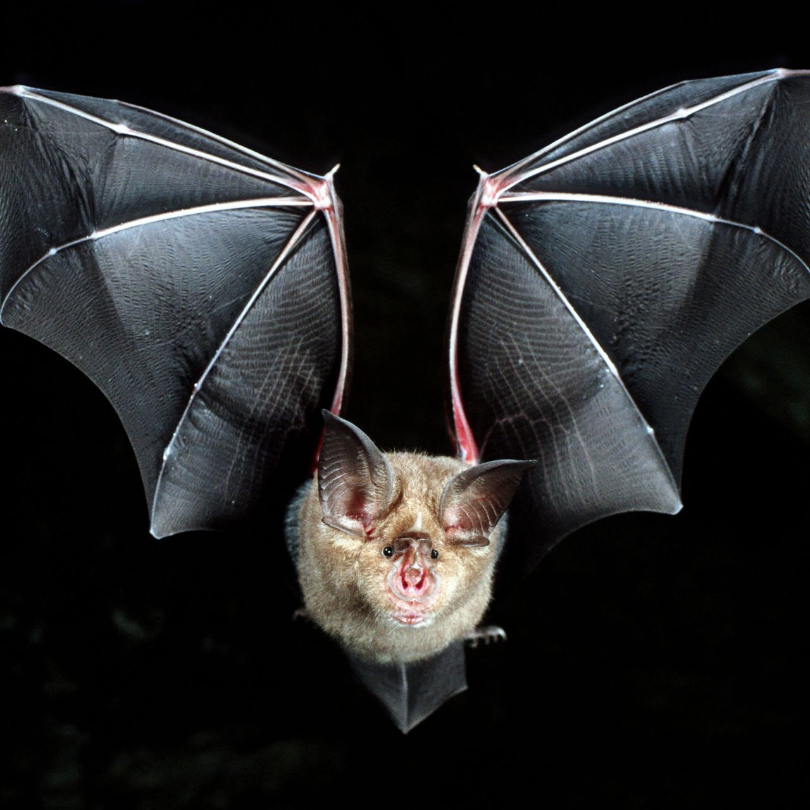
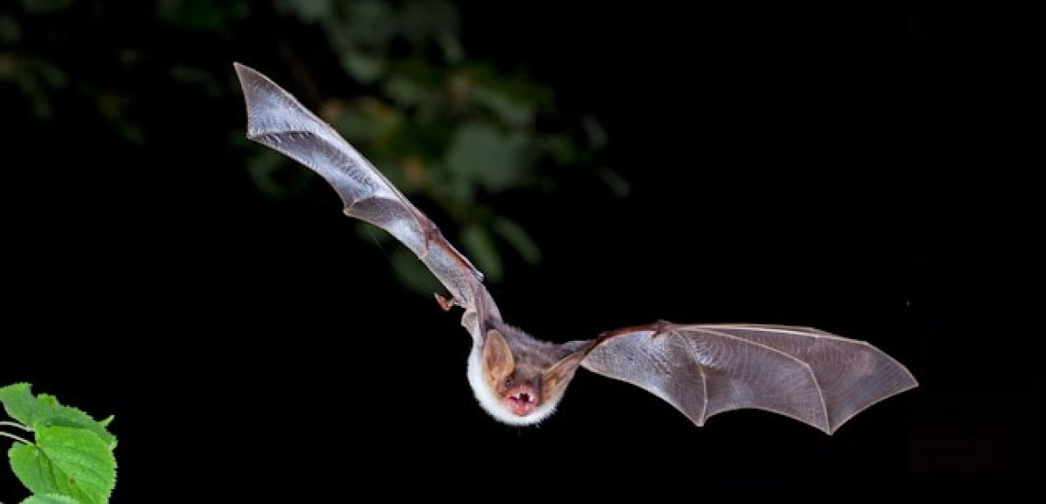
Fun fact: A lot of the corona viruses actually originate from bats

Slide 4
Social impacts
The corona virus is really dangerous, but in this presentations we will focus on its impacts in the people’s social life. We will talk about the psychological, educational, religious impact and the damage that it has brought to work.

Slide 5
Educational impact
The COVID-19 pandemic has affected educational systems worldwide, leading to the near-total closures of schools, universities and colleges.
Most countries around the world have temporarily closed educational institutions in an attempt to contain the spread of COVID-19. As of 7 June 2020, approximately 1.725 billion learners are currently affected due to school closures in response to the pandemic.

Slide 6
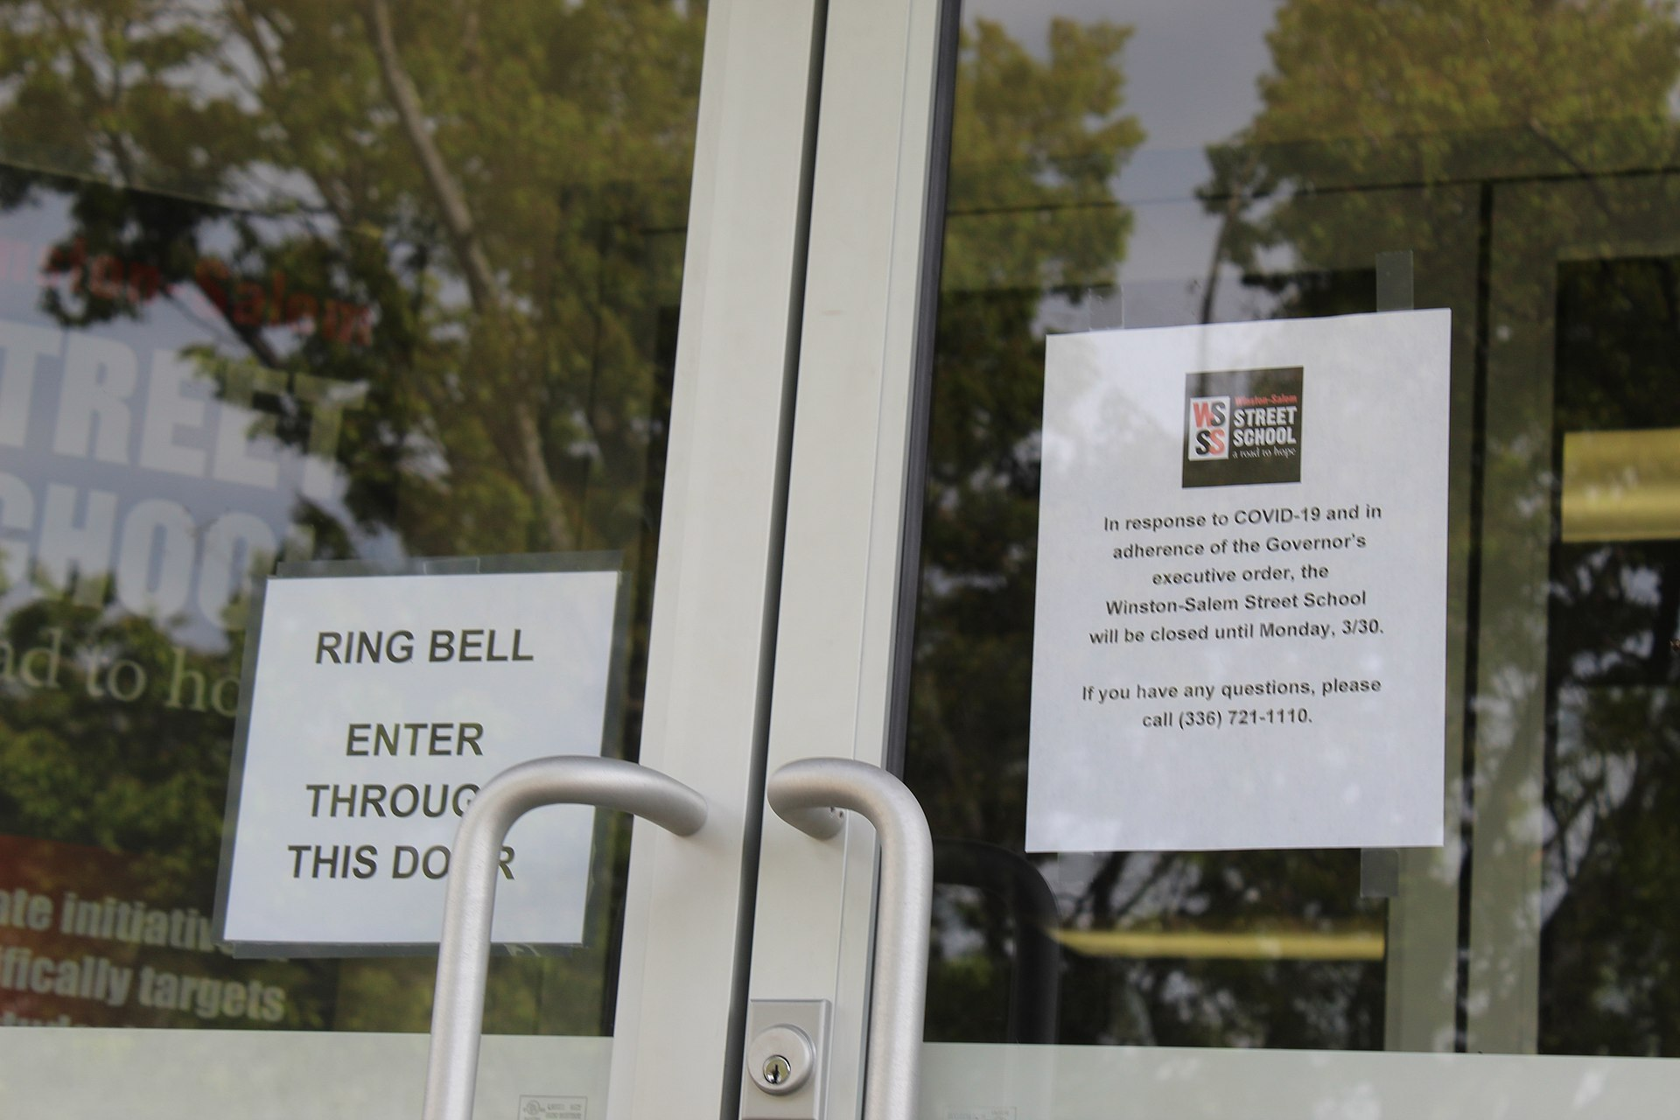
School closed due to the COVID-19 pandemic

Slide 7
School closures in response to the pandemic have shed light on various social and economical issues, including student debt, digital learning, food insecurity, and homelessness, as well as access to childcare, health care, housing, internet, and disability services. The impact was more severe for disadvantaged children and their families, causing interrupted learning, compromised nutrition, childcare problems, and consequent economic cost to families who could not work

Slide 8
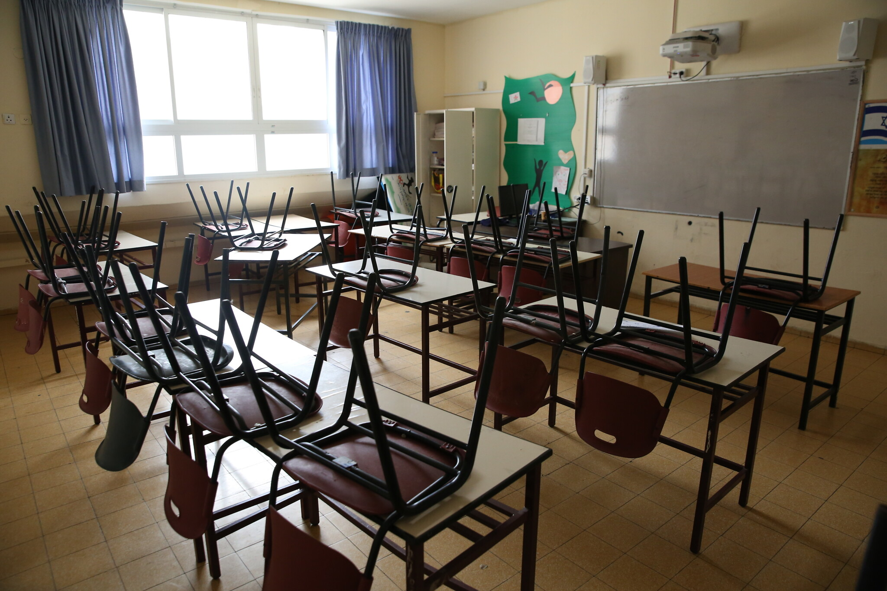
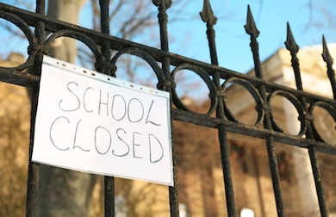

Slide 9
Corona virus and inequality
The poor are more likely to get the Corona virus and die because of it. They lack the funds to actually get medical care. There are theories why more poor people tend to get the virus more. One theory states that poor people live in more crowded places and because of the social contact, they are more likely to meet someone who is infected. A lot of low income workers also lost their jobs due to the virus.

Slide 10



Slide 11
Religious impact
The pandemic has affected religion in a lot of ways. From the cancellation of worshiping events, to the closure of the Sunday Church Schools as well as the cancellation of pilgrimages. Like schools, mosques, churches, synagogues and temples were closed for public use, so the spread of the virus can be stopped.
Relief wings of religious organisations have dispatched medical supplies and other aid to affected areas

Slide 12
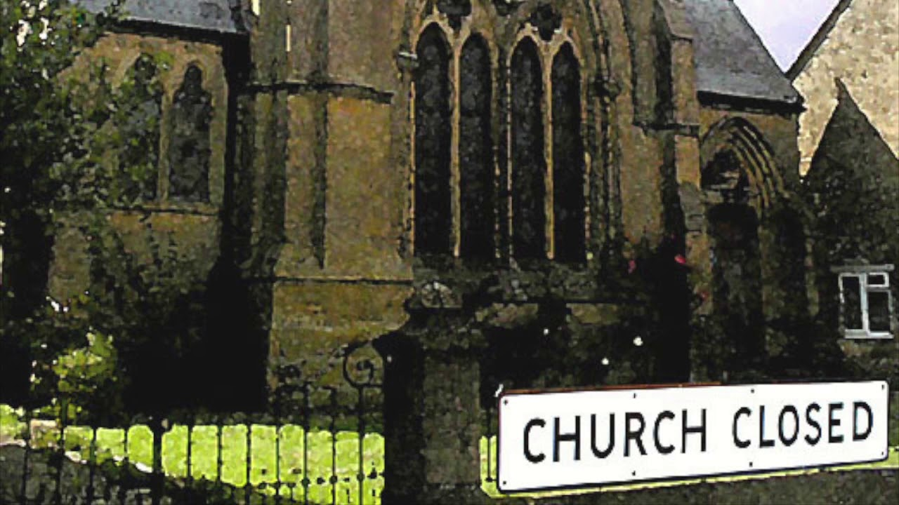
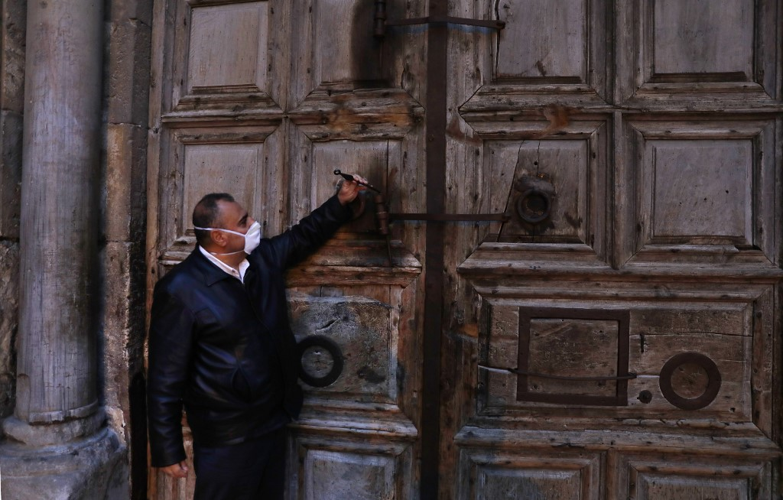

Slide 13
Psychological effect
Because of the virus, people’s mental health deteriorated. Fear of getting sick, unemployed, and the fact the you could not leave your home for extended period of time brought crippling fear to some. People started fearing their own animals, because it was rumored that animals could spread the virus further.
That’s why experts fear that there will be a rise in suicide cases in the near future, although there is no empirical evidence.

Slide 14
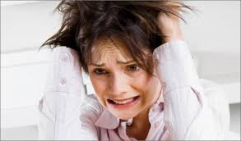

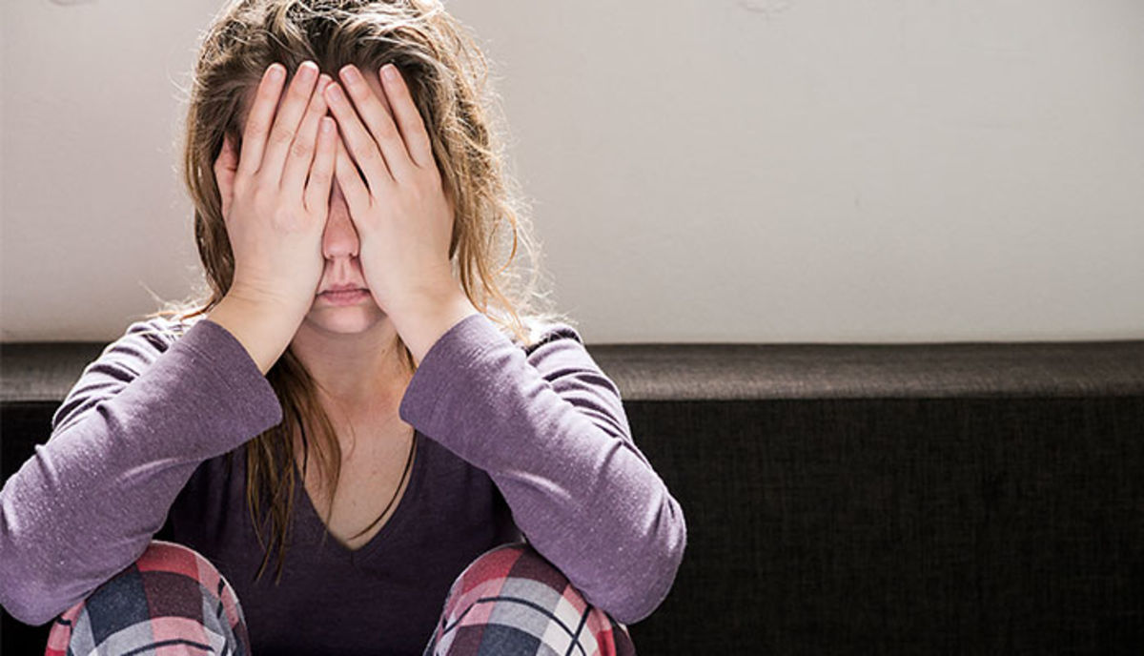

Slide 15
Domestic violence
Unfortunately, may countries report rise of domestic violence and intimate partner violence. That can be explained by the lockdowns, or the stress that is brought by working from home, financial stress and uncertainty.
Abusers now can actually control even larger part of their victims’ life.

Slide 16
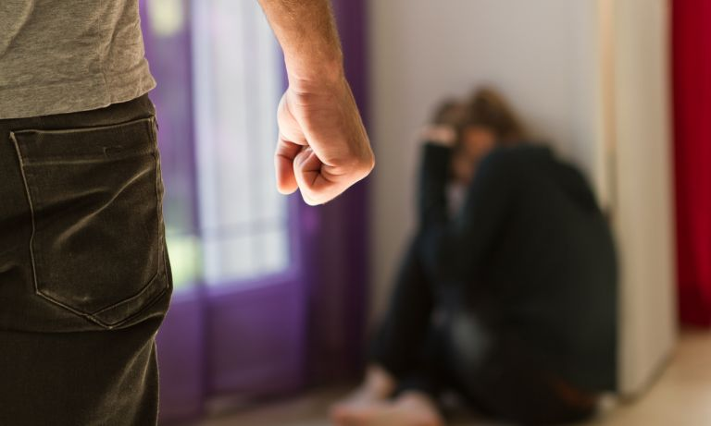

Slide 17
Thank you for your time! Stay safe!
Made by Stefan Stefanov.

